Slide 1


OOP
جامعة المرقب
كلية تقنية المعلومات
Constructors & Inheritance
المحاضرة7
خريف 2026/2025‏

Slide 2
Constructor Behavior in Inheritance
In C++, When create an object of a derived, the constructor of the parent class is executed first, followed by the constructor of the child class. It mean in following order:
  Base Class Constructor: Called first to initialize the inherited part of the object.
  Derived Class Constructor: Called second to initialize the unique part of the object.
Why this order?
This ensures that the base class is properly initialized before the derived class adds its own functionality.

Slide 3
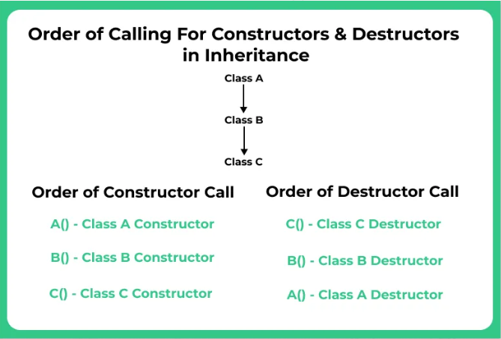
.
c;lass C

Slide 4
Example1:Oroder for calling constructors
#include <iostream>
class Base {
public:
Base() {
cout << “1-Base constructor called" << endl;
}
};
class Derived : public Base {
public:
Derived() {
cout << “2-Derived constructor called" << std::endl;
}
};
int main() {
Derived d;
return 0;
}
The first one calling Base class
The Second class calling Derived class
// Creating an object of Derived class
Out put :
1-Base constructor called
2-Derived constructor called

Slide 5
Calling Base Constructors

Slide 6
1-Implicit Call (Base Default Constructor)
If the base class has a Default Constructor (a constructor that takes no parameters), the derived class constructor will call it implicitly (automatically) if you don't specify any other base constructor.
Requirement: For implicit calling to work, the base class must have a public, accessible default constructor..

Slide 7
Example 1
#include <iostream>
class Animal {
public:
// Default constructor for Animal
Animal() {
cout << "Animal Created with Default Constructor" << endl;
}};
class Dog : public Animal {
public:
// Default constructor for Dog
Dog() : Animal() { // Call to base class default constructor
cout << "Dog Created with Default Constructor" << endl;
}};
int main() {
Dog dog; // Creating a Dog, which also creates an Animal
return 0;}

Slide 8
Explanation Exampl1:
Base Class (Animal):
The default constructor Animal() prints a message when an Animal object is created.
Derived Class (Dog):
The Dog class constructor also calls the base class default constructor using the initializer list ( Animal()). It also prints a message when a Dog object is created.
Main Function:
When create an instance of Dog, it implicitly calls the default constructor of Animal

Slide 9
Example2
#include <iostream>
using namespace std;
class Base {
public:
int ID;
Base() : ID(30) {
cout << "Base ID: " << ID << endl; // Output the ID initialized in the Base class
}};
class Derived : public Base {
public:
Derived():Base() {
cout << "This is ID from Derived class." << endl; }};
int main() {
Derived h; // Create an instance of Derived class
return 0;
}

Slide 10
Explanation Exampl2:
Base Initialization: The program immediately jumps to the Base constructor. It sets ID to 30 and prints:”Base ID: 30”
Derived Initialization: Once the Base is ready, control returns to the Derived constructor. It prints:”This is ID from Derived class”.

Slide 11
2-Explicit Call (Base Parameterized)
An explicit call occurs when the derived class constructor must specify which base class constructor to use and what arguments to pass it. This is done using the Member Initializer List.
When it Happens:
  When the base class only has a parameterized constructor and no default constructor.
  When the base class has multiple constructors, and the derived class needs to call a specific parameterized constructor.
You must explicitly name the base class constructor in the derived constructor's definition.

Slide 12
Example : has a parameterized constructor
#include <iostream>
class Base {
public:
// Parameterized constructor for Base
Base(int x):x(y) {
cout << "Base constructor called with value: " << x << endl;
}
};
class Derived : public Base {
public:
int a;
// Parameterized constructor for Derived
Derived(int y, int z) : Base(y), a(z){ // Call Base constructor with y
cout << "Derived constructor called with value: " << z << endl;
}
};
int main() {
// Creating an instance of Derived class
Derived d(10, 20);
return 0;
}

Slide 13
Explanation: calling a parameterized constructor
1-Before the Derived constructor does anything, it uses the initialization list : Base(y), a(z) to pass data.
  The value of y (10) is sent up to the Base constructor.
  The value of z (20) is used to initialize the local variable a.
2. Base Constructor Execution
  The program enters the Base constructor:
  The parameter x receives the value 10.
3. Derived Constructor Execution
  Control returns to the Derived constructor to finish the setup:
  The code inside the curly braces {} runs.
4-Final Output:
  Base constructor called with value: 10
Derived constructor called with value: 20

